Slide 1



Slide 2



Slide 3

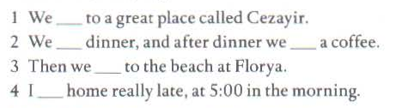
went
had
had
went
got

Slide 4



Slide 5
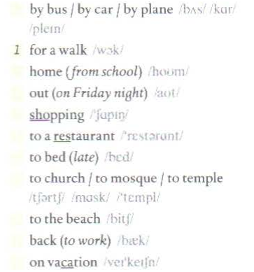
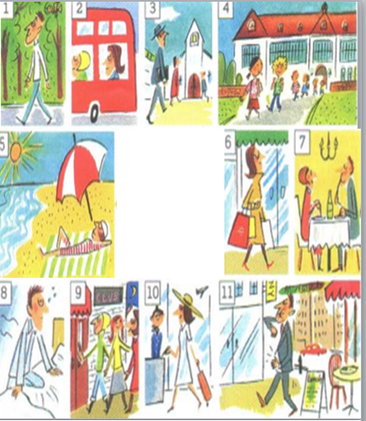
2
4
9
go
6
7
8
3
5
11
10

Slide 6
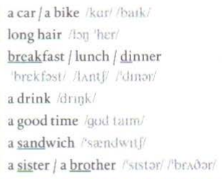
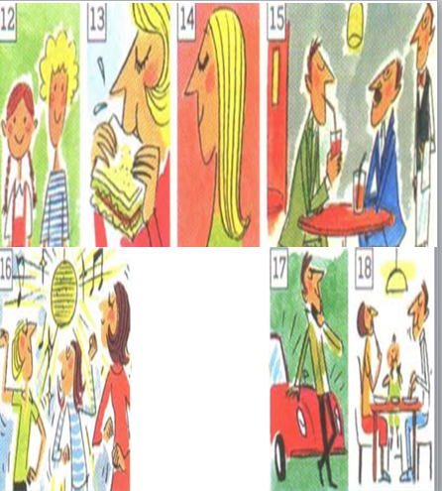
17
14
18
15
16
have
13
12

Slide 7
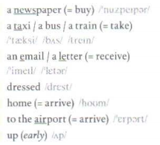
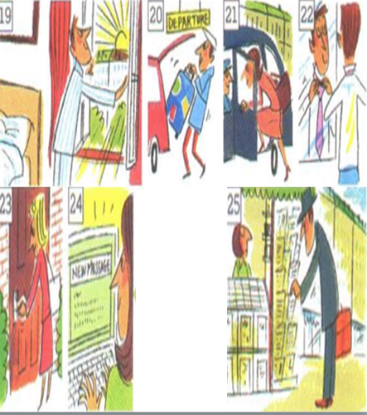
25
21
24
22
get
23
20
19

Slide 8

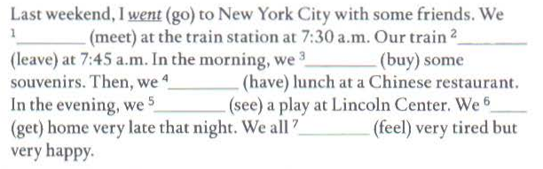
EXERCISE
met
left
bought
had
saw
got
felt

Slide 9
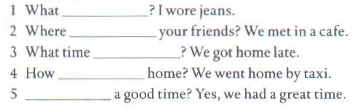

Slide 10




did you wear
did you meet
did you get home
did you go
Did you have

Slide 11

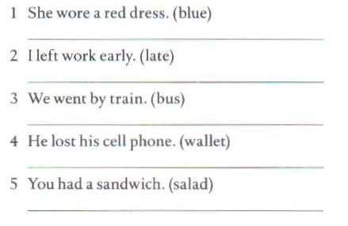
She wore a blue dress.
I left work late.
We went by bus.
He lost his wallet.
You had a salad.

Slide 12


Slide 13

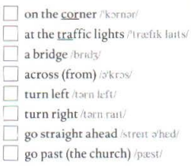
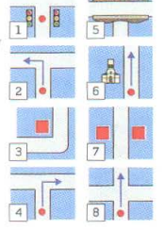
3
1
5
7
2
4
8
6

Slide 14
HOMEWORK
- Learn vocabulary by hearth.
- Prepare next lessons.

Slide 15

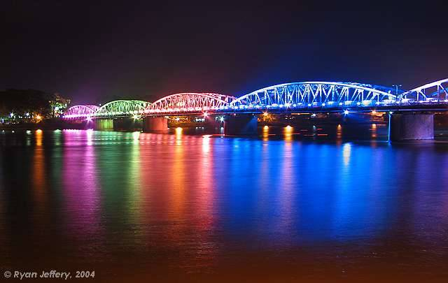


Thank you for your attention!

